Slide 1


Billing Management System
Tauqir Momin 21104064
Yash Nakwa 21104051
Pratham Kataria 21104118
Project Guide
Prof. Shweta Mahajan

Slide 2
Contents
Introduction
Objectives
Scope
Features / Functionality
Project Outcomes
Technology Stack
Block Diagram if applicable

Slide 3
1. Introduction
    A billing management system app is an application that allows businesses to manage their billing and invoicing processes more efficiently.
    The app can automate various tasks, such as generating invoices, tracking payments, and managing customer accounts.
    The billing management system app can be used by various types of businesses, including small and medium-sized enterprises (SMEs) and large corporations.
    The app can be customized to meet the specific needs of the business, and it can be integrated with other applications, such as accounting software.

Slide 4
2. Objectives
The objectives of a billing management system app are to streamline the billing and invoicing process for businesses, improve efficiency, and provide valuable insights into financial performance.
Automation
Accuracy
Time-Saving
Improved cash flow
Cost-Effective
Analytics and Insights

Slide 5
3. Scope
The scope of a billing management system app is quite broad, and it can vary depending on the business's specific requirements.
Invoicing: The app can generate invoices based on the products or services provided, with customizable fields such as payment terms, due dates, and taxes.
Payment tracking: The app can track payments received from customers and provide alerts for overdue payments.
Customer management: The app can manage customer accounts, including contact details, payment history, and credit limits.

Slide 6
4. Feature /Functionality
    Here are some common features of a billing management system app:
    Invoicing
    Payment processing
    Inventory management
    Scalability
    Reporting and analytics
    Integration with other systems
    Security and compliance
    User Management
    Customization

Slide 7
5. Outcome of Project
Implementing a billing management system app can lead to several outcomes that can benefit a business.
Improved efficiency
Increased accuracy
Enhanced Customer Experience
Improved Financial Management
Enhanced Security

Slide 8
6. Technology Stack
The technology stack for a billing management system app can vary depending on the specific requirements and features of the app.
Python (Tkinter)
GUI(Graphical User Interface)

Slide 9
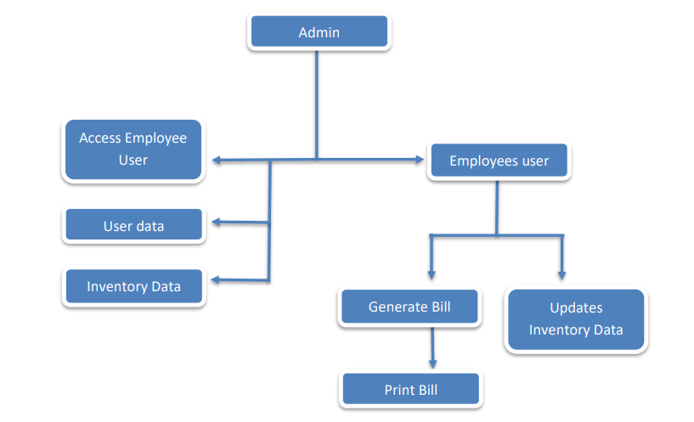
7. Block Diagram

Slide 10
Thank You...!!

